Slide 1

Predicting Student Exam Performance
Dustin Casey

Slide 2
What will be Covered?
Intro/background of the issue
Data background
Data cleansing/EDA
Our methodology
Modeling
Results
Conclusion

Slide 3
Background
Student’s background of personal, social, and economic factors could play a role on their performance in school
Identifying these students could help set them up for success in school and in life
Students that perform well and do not need additional resources
Students that perform poorly who do need additional resources
Students that have resources available to them but do not perform well
Potential underlying learning disability?
Ethical concerns that needed to be addressed
Just because a student’s background might indicate they would be a poor student does not always mean that
I cannot pick and choose which students receive or require these resources
Goal is to help school districts allocate resources appropriately
At the end of the day it is in the student’s hands, but I can do my part in ensuring the schools that need the resources the most are getting them

Slide 4
Data Used - Part 1 - Background
Fictional dataset created by Royce Kimmons and used on Kaggle by Jakki Seshapanpu
1000 rows by 8 columns
Each row corresponds to a different student
3 columns represent metrics in the form of test scores (math, reading, and writing)
Other 5 columns represent personal, social, and economic factors
Gender
Race/Ethnicity
Parental Level of Education
Lunch
Test Preparation Course
One assumption I made was all students were provided with the same equipment and testing environment
Data: https://www.kaggle.com/spscientist/students-performance-in-exams

Slide 5
Data Used - Part 2 - Variables
Gender
Consists of 2 variables, male or female
Race/Ethnicity
Consists of 5 variables, Groups A, B, C, D, and E
Parental Level of Education
Consists of 6 variables, Some High School, High School, Some College, Associate’s Degree, Bachelor’s Degree, Master’s Degree
Lunch
Consists of 2 variables, Standard or Free/reduced
Test Preparation Course
Consists of 2 variables, Completed or None

Slide 6
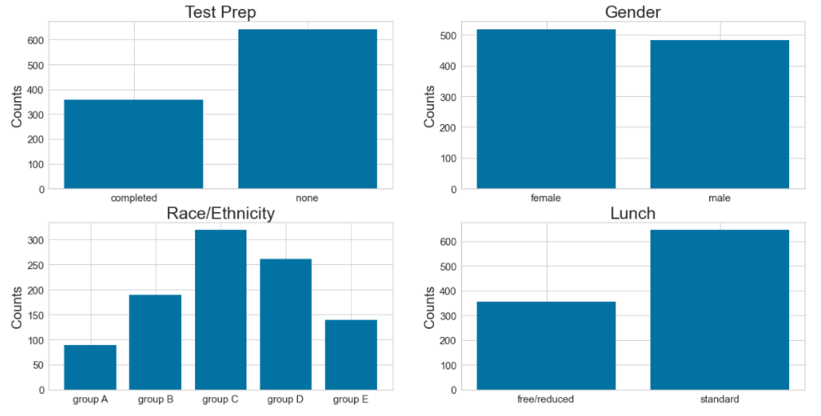
Data Cleansing/EDA
Did not have much cleansing to do
Some things I did:
Remove punctuation from the various variables
Replaced blank spaces with underscores
Created total scores of math, reading, and writing scores combined
Conducted some EDA to see the distribution of variables

Slide 7
Data Cleansing/EDA
Created dummy variables for the categorical features.
Conducted both scaled and unscaled versions
Unscaled version was giving me poorer results for the model
Scaled variables with sklearn.preprocessing’s StandardScaler
This helped standardize features by removing the mean and scaling to unit variance

Slide 8
Methodology
Using the features/variables outlined previously, a regressor model was trained to predict the scores of students math, writing, and reading tests. I have a target variable of “combined scores” that is the sum of the three tests. My goal is to accurately predict what any given student’s “combined score” will be.
I am aiming to have an accurate model that can predict the scores with little to no error.
Using this accurate model, I will be able to predict which students may struggle in producing high testing scores.
For logistic regression, the goal is to identify whether a student would have a passing or failing grade on average (combined score < 60% is my target variable (1)).
My goal with logistic regression is both accuracy while placing an emphasis on recall (limiting false negatives in favor of false positives). This will ensure that I am not missing as many students who need additional help.

Slide 9
Modeling
Simple Linear Regression
Random Forest Regression
1000 Trees
Extra Trees Regression
1000 Trees
Logistic Regression
All models used the same features (all of the available features)

Slide 10
Results - Unscaled Features
Measuring model performance on an accuracy basis (I want MSE, MAE, and RMSE as low as possible; I want R² as close to 1 as possible)
Simple Linear Regression
Mean Squared Error: 138.53
Mean Absolute Error: 9.89
Root Mean Absolute Error: 11.77
R²: 0.216
Random Forest Regressor
Mean Squared Error: 180.02
Mean Absolute Error: 11.16
Root Mean Absolute Error: 13.42
R²: -0.019
Extra Trees Regressor
Mean Squared Error: 197.20
Mean Absolute Error: 11.49
Root Mean Absolute Error: 14.04
R²: -0.116

Slide 11
Results - Scaled Features
Measuring model performance on an accuracy basis (I want MSE, MAE, and RMSE as low as possible; I want R² as close to 1 as possible)
Simple Linear Regression
Mean Squared Error: 0.619
Mean Absolute Error: 0.66
Root Mean Absolute Error: 0.787
R²: 0.215
Random Forest Regressor
Mean Squared Error: 0.804
Mean Absolute Error: 0.75
Root Mean Absolute Error: 0.896
R²: -0.020
Extra Trees Regressor
Mean Squared Error: 0.880
Mean Absolute Error: 0.77
Root Mean Absolute Error: 0.938
R²: -0.117

Slide 12
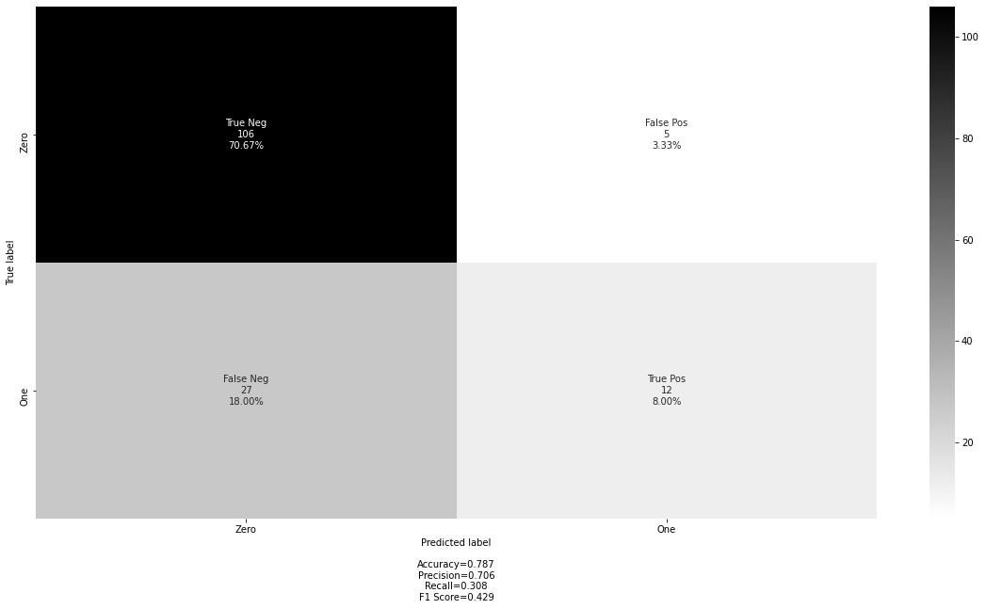
Results – Logistic Regression Unweighted

Slide 13
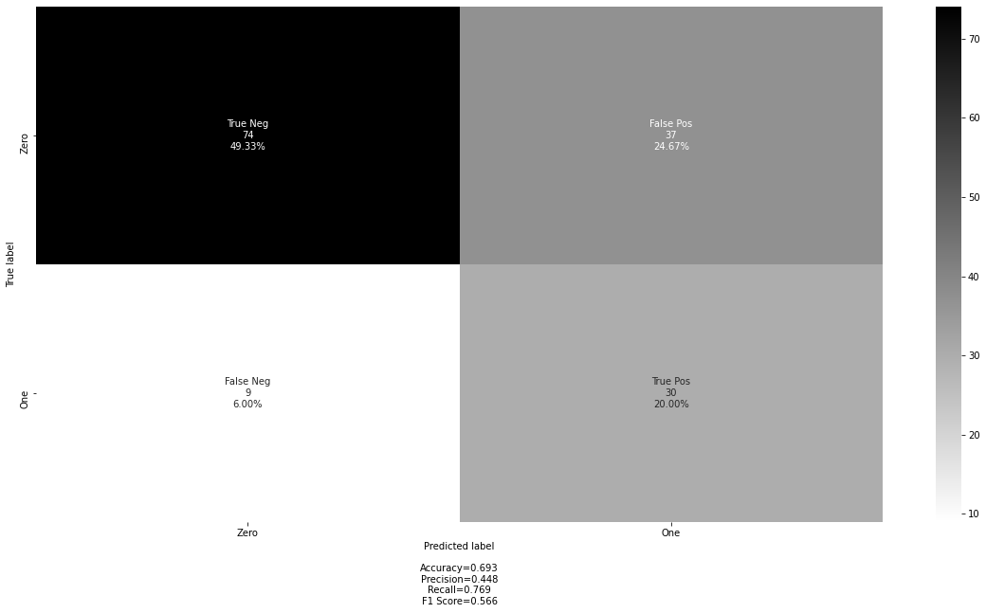
Results – Logistic Regression Weighted

Slide 14
Conclusion
Scaling variables to standardize features by removing the mean and scaling to unit variance didn’t assist much with model fit.
I found the simple linear regression model performed the best when it came to predicting students’ test scores, but with a low R² value, the model still isn’t a great fit.
Because of the poor fit of regression models, logistic regression is a better use model for our goal.
With this model, I can predict students’ test results; this will assist in identifying students who may need more assistance in preparation for these tests.
I can allocate more resources to those schools with students that need the most assistance.

Slide 15
References
Kimmons, R. (n.d.). Exam scores. Retrieved April 17, 2021, from
http://roycekimmons.com/tools/generated_data/exams
Seshapanpu, J. (2018, November 09). Students performance in exams. Retrieved April
17, 2021, from https://www.kaggle.com/spscientist/students-performance-in-exams

